Slide 1
APEX Program
Distressed Area Analysis
Version Number
As of 11 September 2024

Slide 2
Distressed Area Funding
The DoD share of costs is limited to 65%, except in the case that the PTAC is providing services in a “distressed area”, where the DoD share is limited to 85% (10 U.S.C. 4954).
The term “distressed area” means an area that has –
  a per capita income of 80% or less than the State average; or
  an unemployment rate that is 1% greater than the national average for the most recent 24-month period (10 U.S.C. 4951).
Funding Opportunity requires that your application include documentation verifying distressed service area(s), if applicable.
US Department of Commerce, Bureau of Economic Analysis (www.bea.gov) for income data.
Department of Labor, Bureau of Labor Statistics (https://data.bls.gov/PDQWeb/la) for unemployment data.

Slide 3
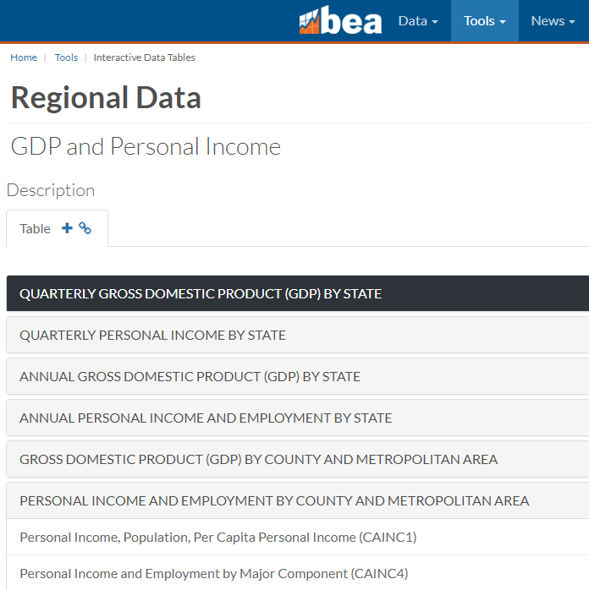
Per Capita Income
Use table CA1 available at - BEA Interactive Data Application to retrieve “per capita personal income” statistics for the most recent year available.
Step 1 – Select table Personal Income by County and Metropolitan Area
Step 2 – Select CAINC1 County and MSA personal income
Summary; personal income, population, per capita personal
income
Step 3 – Select County

Slide 4
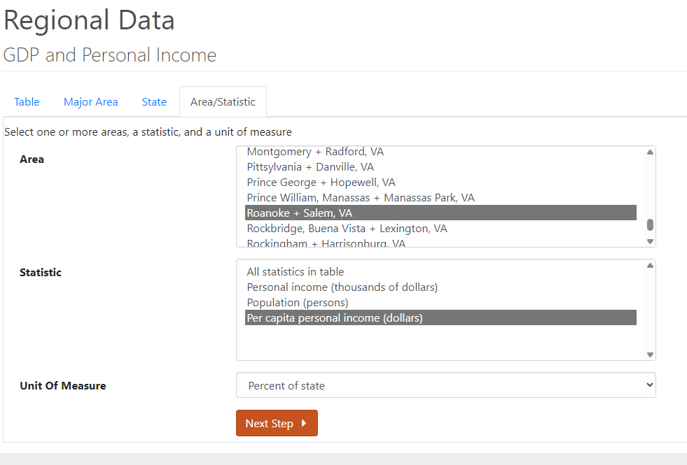
Per Capita Income
Step 4 – Select your State
Step 5 – Choose your county or counties
and make other selections
Select your area (counties)
Select statistic “Per capita personal income (dollars)” Select unit of measure “Percent of state”

Slide 5
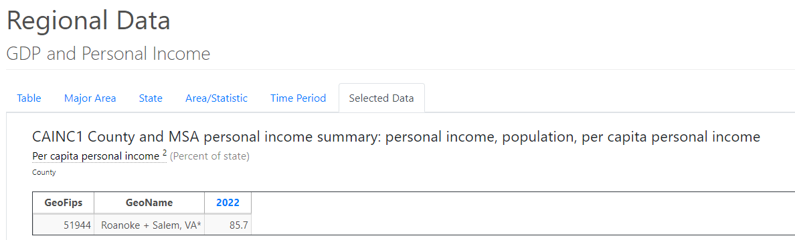
Per Capita Income
Step 6 – Select the most recent year
available and click “Next Step”
Step 7 – Provide a copy of your analysis and clearly state your results.

Slide 6
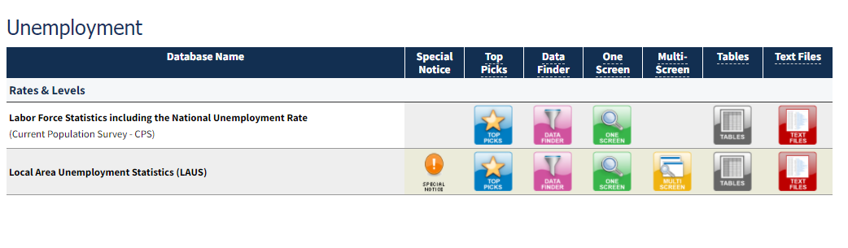
Unemployment Data
Use the Databases, Tables & Calculators by Subject available at https://www.bls.gov/data/ to retrieve data to determine the national employment rate and the unemployment rates for counties and equivalents.
National Unemployment Rate
Local Area Unemployment Rate

Slide 7
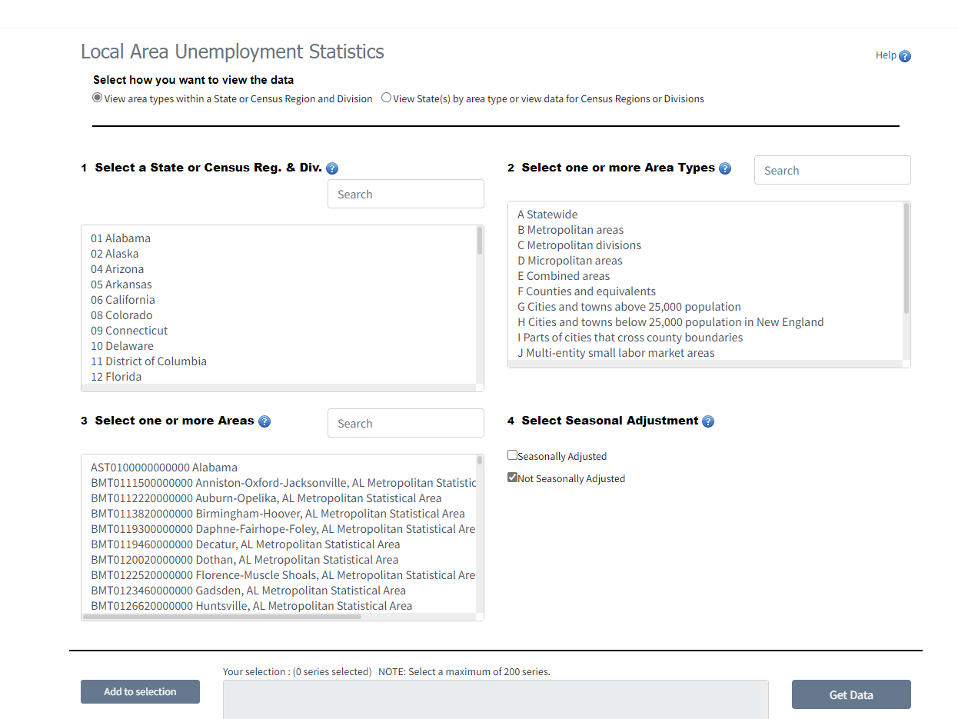
Unemployment Data
Step 1 - Use the Local Area Unemployment Statistics database available at https://data.bls.gov. Under the Unemployment, Local Area Unemployment Statistics click on the “One Screen” icon to retrieve “not seasonally adjusted” unemployment rates for counties and equivalents.

Slide 8
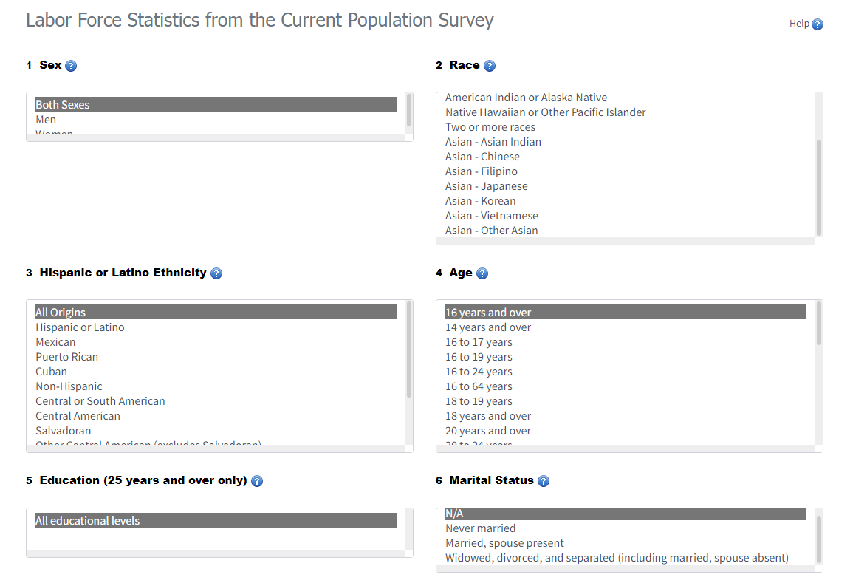
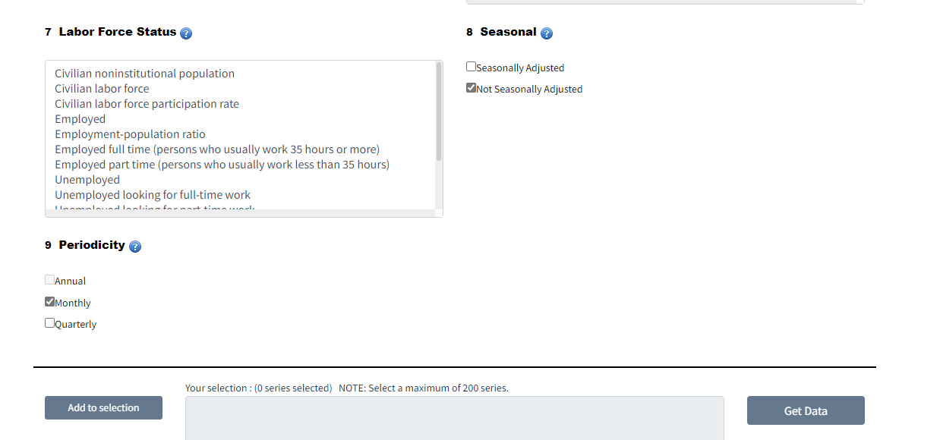
Unemployment Data
Step 2 - Use the National Unemployment Statistics database available at https://data.bls.gov Under the Unemployment, Labor Force Statistics including the national unemployment rate click on the “One Screen” icon to retrieve the national unemployment rate. Select “Not Seasonally Adjusted” and “Monthly”.

Slide 9
Unemployment Data
Step 3 – Determine the most recent 24-month period for which both national and local area statistics are available.
- Exclude Annual and Preliminary data from your analysis.
- In this example, the most recent 24-month period is August 2009 through July 2011.

Slide 10
Unemployment Data
Step 4 – Compare national and county data
Step 5 – Provide a copy of
your analysis and clearly state
your results.

