Slide 1
APEX Program
“Statewide Coverage” analysis guidance pursuant to Notice for Funding
Opportunity
Version Number
As of 17 July 2025

Slide 2
Funding Limitations are set by statute. See the Notice of Funding Opportunity for specific thresholds.
Statewide Coverage is defined in the Notice for Funding document.
  Service at least 50 percent of the State’s Counties; and
  75 percent of the State’s labor force.
Funding Opportunity requires that your application include documentation verifying statewide coverage, if applicable.
  Department of Labor, Bureau of Labor Statistics (www.bls.gov)
  Local Area “Labor Force” statistics are available at http://data.bls.gov/pdq/querytool.jsp?survey=la
  You can also find consolidated tables for annual labor force data at http://www.bls.gov/lau/home.htm
  Use the most recent, annual labor force data available.

Slide 3
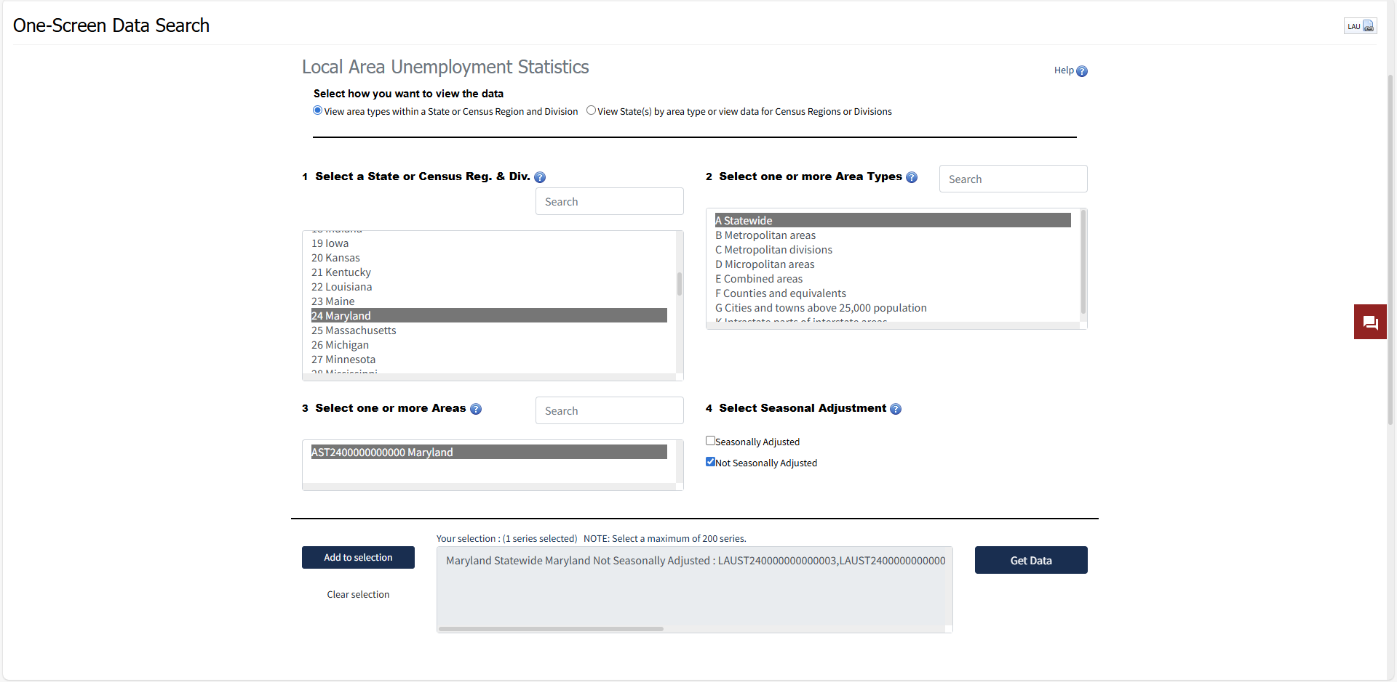
Step 1 Retrieve Statewide Data

Slide 4
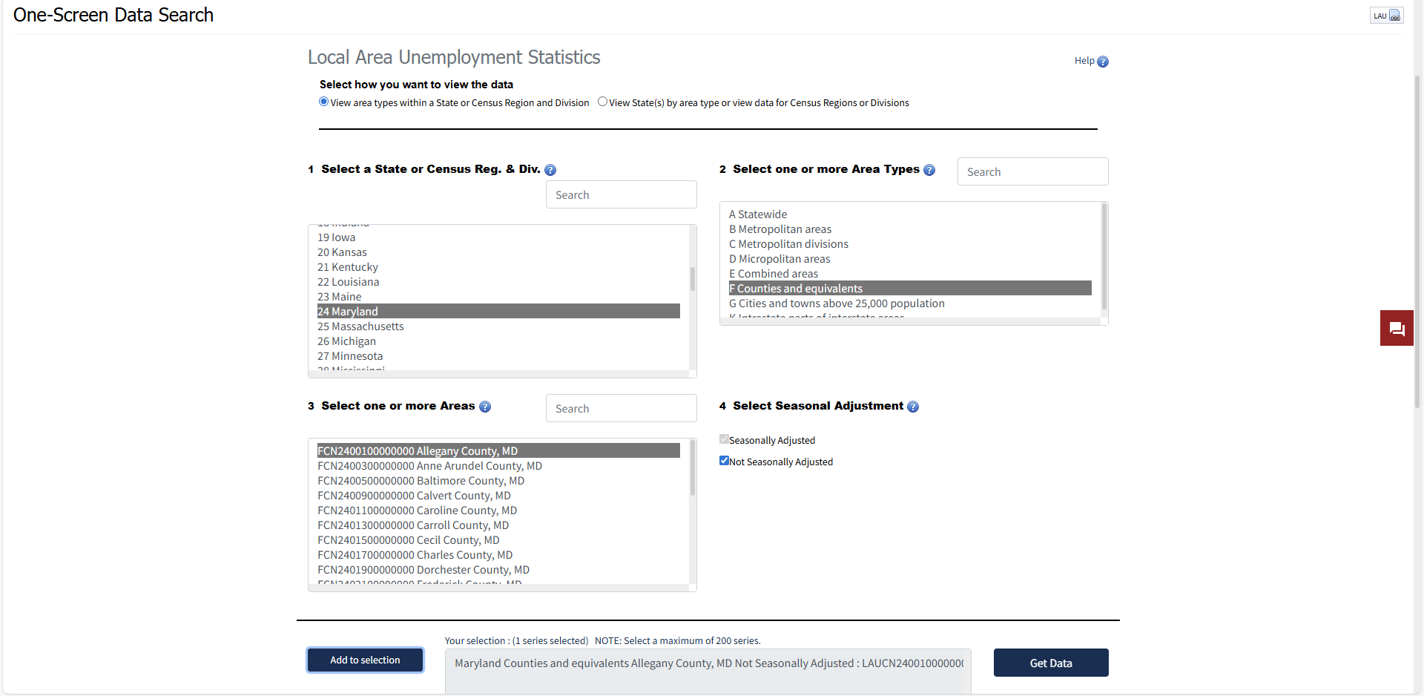
Step 2 - Retrieve Data for Counties and Equivalents

Slide 5
Step 3 - Compare the most recent annual statistics available
Statewide Data
County Data

Slide 6
Step 4 - Provide a copy of your analysis and clearly state your results.
The APEX Accelerator provides service to ## of the ## total counties in (Your State), which is ##%.
The Apex Accelerator provides service to ## of (Your State)'s total labor force of ##, which is ##%.

